Slide 1

Operating Systems Design​ Session 39: Deadlocks
19CS2106R​
© 2020 KL University

Slide 2
Common Concurrency Problems
More recent work focuses on studying other types of common concurrency bugs.
Take a brief look at some example concurrency problems found in real code bases.
Focus on four major open-source applications
MySQL, Apache, Mozilla, OpenOffice.
Application | What it does | Non-Deadlock | Deadlock
MySQL | Database Server | 14 | 9
Apache | Web Server | 13 | 4
Mozilla | Web Browser | 41 | 16
Open Office | Office Suite | 6 | 2
Total |  | 74 | 31
Bugs In Modern Applications
Make up a majority of concurrency bugs.
Two major types of non deadlock bugs:
Atomicity violation
Order violation

Slide 3
Atomicity-Violation Bugs
The desired serializability among multiple memory accesses is violated.
Simple Example found in MySQL:
Two different threads access the field proc_info in the struct thd.
1 Thread1::
2 if(thd->proc_info){
3 …
4 fputs(thd->proc_info , …);
5 …
6 }
7
8 Thread2::
9 thd->proc_info = NULL;

Slide 4
Atomicity-Violation Bugs (Cont.)
Solution: Simply add locks around the shared-variable references.
pthread_mutex_t lock = PTHREAD_MUTEX_INITIALIZER;
Thread1::
pthread_mutex_lock(&lock);
if(thd->proc_info){
…
fputs(thd->proc_info , …);
…
}
pthread_mutex_unlock(&lock);
Thread2::
pthread_mutex_lock(&lock);
thd->proc_info = NULL;
pthread_mutex_unlock(&lock);

Slide 5
Order-Violation Bugs
The desired order between two memory accesses is flipped.
i.e., A should always be executed before B, but the order is not enforced during execution.
Example:
The code in Thread2 seems to assume that the variable mThread has already been initialized (and is not NULL).
Thread1::
void init(){
mThread = PR_CreateThread(mMain, …);
}
Thread2::
void mMain(…){
mState = mThread->State
}

Slide 6
Order-Violation Bugs (Cont.)
Solution: Enforce ordering using condition variables
pthread_mutex_t mtLock = PTHREAD_MUTEX_INITIALIZER;
pthread_cond_t mtCond = PTHREAD_COND_INITIALIZER;
int mtInit = 0;
Thread 1::
void init(){
…
mThread = PR_CreateThread(mMain,…);
// signal that the thread has been created.
pthread_mutex_lock(&mtLock);
mtInit = 1;
pthread_cond_signal(&mtCond);
pthread_mutex_unlock(&mtLock);
…
}
Thread2::
void mMain(…){
…

Slide 7
Order-Violation Bugs (Cont.)
// wait for the thread to be initialized …
pthread_mutex_lock(&mtLock);
while(mtInit == 0)
pthread_cond_wait(&mtCond, &mtLock);
pthread_mutex_unlock(&mtLock);
mState = mThread->State;
…
}

Slide 8
Deadlock Bugs
The presence of a cycle
Thread1 is holding a lock L1 and waiting for another one, L2.
Thread2 that holds lock L2 is waiting for L1 to be release.
Thread 1: lock(L1); lock(L2); | Thread 2: lock(L2); lock(L1);
Thread 1
Holds
Lock L1
Wanted by
Wanted by
Lock L2
Thread 2
Holds

Slide 9
Conditional for Deadlock
Four conditions need to hold for a deadlock to occur.
If any of these four conditions are not met, deadlock cannot occur.
Condition | Description
Mutual Exclusion | Threads claim exclusive control of resources that they require.
Hold-and-wait | Threads hold resources allocated to them while waiting for additional resources
No preemption | Resources cannot be forcibly removed from threads that are holding them.
Circular wait | There exists a circular chain of threads such that each thread holds one more resources that are being requested by the next thread in the chain

Slide 10
Prevention – Circular Wait
Provide a total ordering on lock acquisition
This approach requires careful design of global locking strategies.
Example:
There are two locks in the system (L1 and L2)
We can prevent deadlock by always acquiring L1 before L2.

Slide 11
Prevention – Hold-and-wait
Acquire all locks at once, atomically.
This code guarantees that no untimely thread switch can occur in the midst of lock acquisition.
Problem:
Require us to know when calling a routine exactly which locks must be held and to acquire them ahead of time.
Decrease concurrency
1 lock(prevention);
2 lock(L1);
3 lock(L2);
4 …
5 unlock(prevention);

Slide 12
Prevention – No Preemption
Multiple lock acquisition often gets us into trouble because when waiting for one lock we are holding another.
trylock()
Used to build a deadlock-free, ordering-robust lock acquisition protocol.
Grab the lock (if it is available).
Or, return -1: you should try again later.
top:
lock(L1);
if( tryLock(L2) == -1 ){
unlock(L1);
goto top;
}

Slide 13
Prevention – No Preemption (Cont.)
livelock
Both systems are running through the code sequence over and over again.
Progress is not being made.
Solution:
Add a random delay before looping back and trying the entire thing over again.

Slide 14
Prevention – Mutual Exclusion
wait-free
Using powerful hardware instruction.
You can build data structures in a manner that does not require explicit locking.
int CompareAndSwap(int *address, int expected, int new){
if(*address == expected){
*address = new;
return 1; // success
}
return 0;
}

Slide 15
Prevention – Mutual Exclusion (Cont.)
We now wanted to atomically increment a value by a certain amount:
Repeatedly tries to update the value to the new amount and uses the compare-and-swap to do so.
No lock is acquired
No deadlock can arise
livelock is still a possibility.
void AtomicIncrement(int *value, int amount){
do{
int old = *value;
}while( CompareAndSwap(value, old, old+amount)==0);
}

Slide 16
Prevention – Mutual Exclusion (Cont.)
More complex example: list insertion
If called by multiple threads at the “same time”, this code has a race condition.
void insert(int value){
node_t * n = malloc(sizeof(node_t));
assert( n != NULL );
n->value = value ;
n->next = head;
head = n;
}

Slide 17
Prevention – Mutual Exclusion (Cont.)
Solution:
Surrounding this code with a lock acquire and release.
wait-free manner using the compare-and-swap instruction
void insert(int value){
node_t * n = malloc(sizeof(node_t));
assert( n != NULL );
n->value = value ;
lock(listlock); // begin critical section
n->next = head;
head = n;
unlock(listlock) ; //end critical section
}
void insert(int value) {
node_t *n = malloc(sizeof(node_t));
assert(n != NULL);
n->value = value;
do {
n->next = head;
} while (CompareAndSwap(&head, n->next, n));
}

Slide 18
Deadlock Avoidance via Scheduling
In some scenarios deadlock avoidance is preferable.
Global knowledge is required:
Which locks various threads might grab during their execution.
Subsequently schedules said threads in a way as to guarantee no deadlock can occur.

Slide 19
Example of Deadlock Avoidance via Scheduling (1)
We have two processors and four threads.
Lock acquisition demands of the threads:
A smart scheduler could compute that as long as T1 and T2 are not run at the same time, no deadlock could ever arise.
 | T1 | T2 | T3 | T4
L1 | yes | yes | no | no
L2 | yes | yes | yes | no
CPU 1
T3
T4
CPU 2
T1
T2

Slide 20
Example of Deadlock Avoidance via Scheduling (2)
More contention for the same resources
A possible schedule that guarantees that no deadlock could ever occur.
The total time to complete the jobs is lengthened considerably.
 | T1 | T2 | T3 | T4
L1 | yes | yes | yes | no
L2 | yes | yes | yes | no
CPU 1
T4
CPU 2
T1
T2
T3

Slide 21
Detect and Recover
Allow deadlock to occasionally occur and then take some action.
Example: if an OS froze, you would reboot it.
Many database systems employ deadlock detection and recovery technique.
A deadlock detector runs periodically.
Building a resource graph and checking it for cycles.
In deadlock, the system need to be restarted.

Slide 22
Resources
Resource types R₁, R₂, . . ., R_{m}
CPU cycles, memory space, I/O devices
Each resource type R_{i} has W_{i} instances.
Sequence of events required to use a resource
Request the resource.
Use the resource.
Release the resource.

Slide 23
The Deadlock Problem
A set of blocked processes each holding a resource and waiting to acquire a resource held by another process in the set
Example
System has 2 disk drives
P₁ and P₂ each hold one disk drive and each needs another one
Example
semaphores A and B, initialized to 1
P₀ P₁
wait (A); wait(B)
wait (B); wait(A)

Slide 24
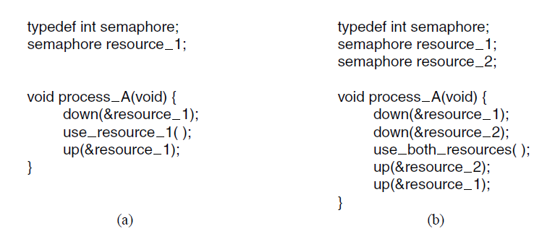
Resource Acquisition (1)

Slide 25
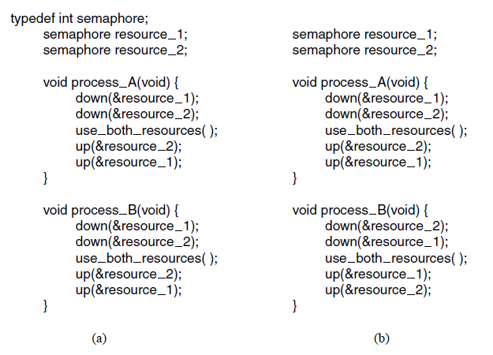
Resource Acquisition (2)

Slide 26
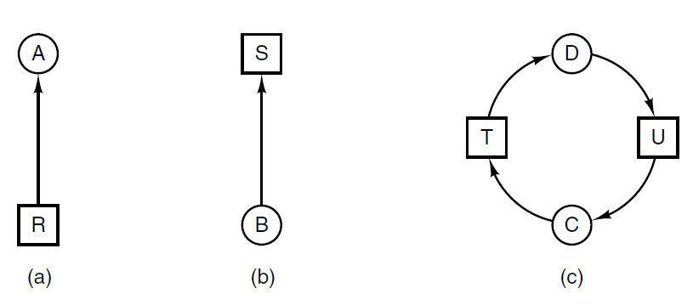
Deadlock Modeling (1)

Slide 27
Basic Facts
If graph contains no cycles ⇒ no deadlock
If graph contains a cycle ⇒
if only one instance per resource type, then deadlock
if several instances per resource type, possibility of deadlock

Slide 28
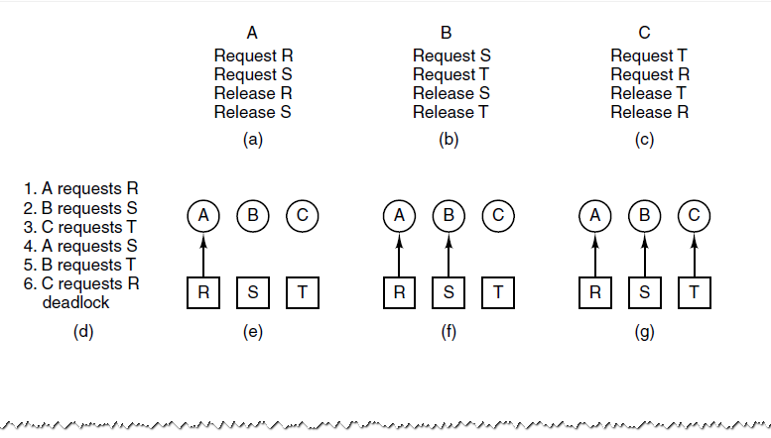
Deadlock Modeling (2)
An example of how deadlock occurs and how it can be avoided.

Slide 29
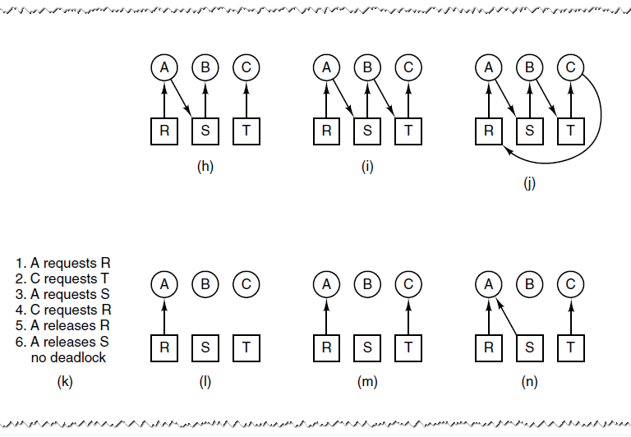
Deadlock Modeling (3)
An example of how deadlock occurs and how it can be avoided.

Slide 30
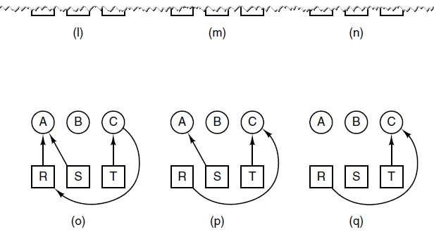
Deadlock Modeling (4)
An example of how deadlock occurs and how it can be avoided.

Slide 31
Several Instances of a Resource Type
Resources in Existence: A vector of length m indicates the total number of resources in the system
Available: A vector of length m indicates the number of available resources of each type.
Allocation: An n x m matrix defines the number of resources of each type currently allocated to each process.
Request: An n x m matrix indicates the current request of each process. If Request [i_{j}] = k, then process P_{i} is requesting k more instances of resource type. R_{j}.

Slide 32
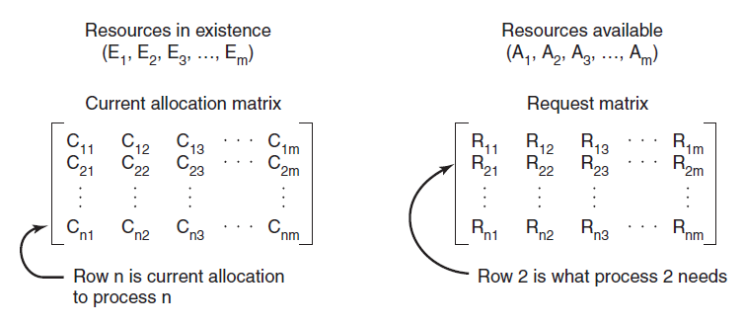
Deadlock Detection with Multiple Resources of Each Type (1)
The four data structures needed by the deadlock detection algorithm.

Slide 33
Deadlock Detection with Multiple Resources of Each Type (2)
Deadlock detection algorithm:
Look for unmarked process, P_{i} , for which the i-th row of R is less than or equal to A.
If such a process is found, add the i-th row of C to A, mark the process, go back to step 1.
If no such process exists, algorithm terminates.

Slide 34
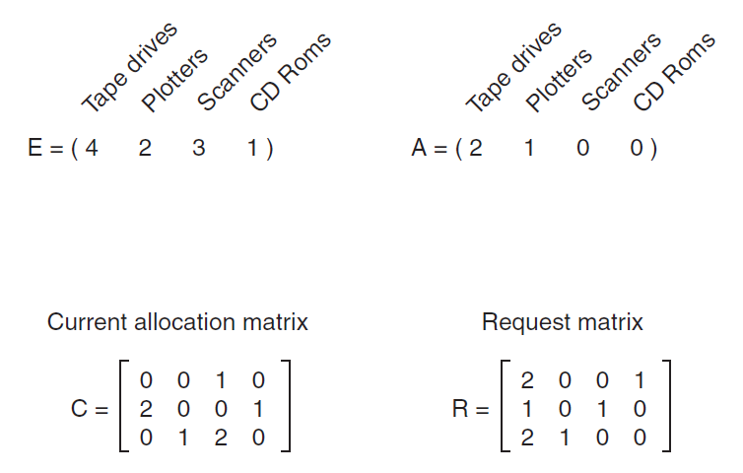
Deadlock Detection with Multiple Resources of Each Type (3)
Figure 6-7. An example for the deadlock detection algorithm.

Slide 35
Safe State
When a process requests an available resource, system must decide if immediate allocation leaves the system in a safe state
System is in safe state if there exists a sequence <P₁, P₂, …, P_{n}> of ALL the processes is the systems such that for each P_{i}, the resources that P_{i} can still request can be satisfied by currently available resources + resources held by all the P_{j}, with j < i
That is:
If P_{i} resource needs are not immediately available, then P_{i} can wait until all P_{j} have finished
When P_{j} is finished, P_{i} can obtain needed resources, execute, return allocated resources, and terminate
When P_{i} terminates, P_{i +1} can obtain its needed resources, and so on

Slide 36
Resource-Allocation Graph
A set of vertices V and a set of edges E.
V is partitioned into two types:
P = {P₁, P₂, …, P_{n}}, the set consisting of all the processes in the system
R = {R₁, R₂, …, R_{m}}, the set consisting of all resource types in the system
request edge – directed edge P₁ → R_{j}
assignment edge – directed edge R_{j} → P_{i}

Slide 37
Resource-Allocation Graph (Cont.)
Process
Resource Type with 4 instances
P_{i} requests instance of R_{j}
P_{i} is holding an instance of R_{j}
P_{i}
R_{j}
P_{i}
R_{j}

Slide 38
Example of Detection Algorithm
Five processes P₀ through P₄; three resource types A (7 instances), B (2 instances), and C (6 instances)
Snapshot at time T₀:
Allocation Request Available
A B C A B C A B C
P₀ 0 1 0 0 0 0 0 0 0
P₁ 2 0 0 2 0 2
P₂ 3 0 3 0 0 0
P₃ 2 1 1 1 0 0
P₄ 0 0 2 0 0 2
Sequence <P₀, P₂, P₃, P₁, P₄> will result in Finish[i] = true for all i

Slide 39
Example (Cont.)
P₂ requests an additional instance of type C
Request
A B C
P₀ 0 0 0
P₁ 2 0 1
P₂ 0 0 1
P₃ 1 0 0
P₄ 0 0 2
State of system?
Can reclaim resources held by process P₀, but insufficient resources to fulfill other processes; requests
Deadlock exists, consisting of processes P₁, P₂, P₃, and P₄

Slide 40
Banker’s Algorithm
Multiple instances
Each process must a priori claimmaximum use
When a process requests a resource it may have to wait
When a process gets all its resources it must return them in a finite amount of time

Slide 41
Data Structures for the Banker’s Algorithm
Let n = number of processes, and m = number of resources types.
Available: Vector of length m. If available [j] = k, there are k instances of resource type R_{j} available
Max: n x m matrix. If Max [i,j] = k, then process P_{i} may request at most k instances of resource type R_{j}
Allocation: n x m matrix. If Allocation[i,j] = k then P_{i} is currently allocated k instances of R_{j}
Need: n x m matrix. If Need[i,j] = k, then P_{i} may need k more instances of R_{j} to complete its task
Need [i,j] = Max[i,j] – Allocation [i,j]

Slide 42
Safety Algorithm
1. Let Work and Finish be vectors of length m and n, respectively. Initialize:
Work = Available
Finish [i] = false for i = 0, 1, …, n- 1
2. Find and i such that both:
(a) Finish [i] = false
(b) Need_{i} ≤ Work
If no such i exists, go to step 4
3. Work = Work + Allocation_{i} Finish[i] = true go to step 2
4. If Finish [i] == true for all i, then the system is in a safe state

Slide 43
Resource-Request Algorithm for Process P_{i}
Request = request vector for process P_{i}. If Request_{i} [j] = k then process P_{i} wants k instances of resource type R_{j}
1. If Request_{i} ≤ Need_{i} go to step 2. Otherwise, raise error condition, since process has exceeded its maximum claim
2. If Request_{i} ≤ Available, go to step 3. Otherwise P_{i} must wait, since resources are not available
3. Pretend to allocate requested resources to P_{i} by modifying the state as follows:
Available = Available – Request;
Allocation_{i} = Allocation_{i} + Request_{i};
Need_{i} = Need_{i} – Request_{i};
If safe ⇒ the resources are allocated to Pi
If unsafe ⇒ Pi must wait, and the old resource-allocation state is restored

Slide 44
Example of Banker’s Algorithm
5 processes P₀ through P₄;
3 resource types:
A (10 instances), B (5instances), and C (7 instances)
Snapshot at time T₀:
Allocation Max Available
A B C A B C A B C
P₀ 0 1 0 7 5 3 3 3 2
P₁ 2 0 0 3 2 2
P₂ 3 0 2 9 0 2
P₃ 2 1 1 2 2 2
P₄ 0 0 2 4 3 3

Slide 45
Example (Cont.)
The content of the matrix Need is defined to be Max – Allocation
Need
A B C
P₀ 7 4 3
P₁ 1 2 2
P₂ 6 0 0
P₃ 0 1 1
P₄ 4 3 1
The system is in a safe state since the sequence < P₁, P₃, P₄, P₂, P₀> satisfies safety criteria

Slide 46
Example: P₁ Request (1,0,2)
Check that Request ≤ Available (that is, (1,0,2) ≤ (3,3,2) ⇒ true
Allocation Need Available
A B C A B C A B C
P₀ 0 1 0 7 4 3 2 3 0
P₁ 3 0 2 0 2 0
P₂ 3 0 1 6 0 0
P₃ 2 1 1 0 1 1
P₄ 0 0 2 4 3 1
Executing safety algorithm shows that sequence < P₁, P₃, P₄, P₀, P₂> satisfies safety requirement
Can request for (3,3,0) by P₄ be granted?
Can request for (0,2,0) by P₀ be granted?

